Slide 1
Azure IoT Hub and MX-ing It Up
!
jhealy@microsoft.com

Slide 2
Azure IoT reference architecture
Core Subsystems
UI & Reporting Tools
Visualize data and learnings
IoT Devices
Provision and send data from device to cloud
Cloud Gateway (IoT Hub)
Stream Processing
Business Integration
Stream processing and rules evaluation over data
Device Management
Storage
Store data
Integrate with business processes
Things
Insights
Actions
Notes:
Speaker notes:
At the core an IoT application consists of the following subsystems: 1) devices (and/or on premise edge gateways) that have the ability to securely register with the cloud, and connectivity options for sending and receiving data with the cloud, 2) a cloud gateway service, or hub, to securely accept that data and provide device management capabilities, 3) stream processors that consume that data, integrate with business processes, and place the data into storage, and 4) a user interface to visualize telemetry data and facilitate device management.

Slide 3
Azure IoT Hub: IoT device management lifecycle
Replace or decommission devices after failure, upgrade cycle or service lifetime
Group devices and control access according to your organization's needs
Retire
Plan
Monitor device inventory, health, and security while providing proactive remediation of issues
Securely authenticate devices, on-board for management and provision for service
Monitor
Provision
Configure
Provide updates, configuration and applications to assign the purpose of each device
Notes:
Talk about IoT Hub device management and IoT Hub Device Provisioning Service in the context of device lifecycle.

Slide 4
Why use IoT Hub?
Telemetry ingestion
Device-to-Cloud messaging
Scale
Device authentication & security (SAC)
Device connectivity monitoring
IoT protocols, device resource optimization

Slide 5
Azure IoT Hub
Designed for IoT
Connect millions of devices
Service assisted communications
Devices are not servers
Use IoT Hub to enable secure bi-directional comms
Cloud-scale messaging
Device-to-cloud and Cloud-to-device
Durable messages (at least once semantics)
Cloud-facing feedback
Delivery receipts, expired messages
Device communication errors
Per-device authentication
Individual device identities and credentials
Connection multiplexing
Single device-cloud connection for all communications (C2D, D2C)
Multi-protocol
Natively supports AMQP, HTTP
Designed for extensibility to custom protocols
Multi-platform
Device SDKs available for multiple platforms (e.g. RTOS, Linux, Windows)
Multi-platform Service SDK.
Notes:
Use Clemens slide?
Focus on specifics.

Slide 6
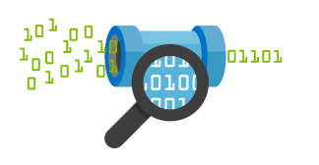

IoT Hub endpoints
Your IoT Hub
Event processing
(hot and cold path)
device
Device id
D2C receive endpoint
D2C send endpoint
Device business logic,
Connectivity monitoring
C2D queue
endpoint
C2D send endpoint
Field GW /
Cloud GW
Msg feedback and monitoring endpoint
Device …
Device …
Device provisioning and management
Device identity management
Device …
IoT Hub management
Notes:
IoT Hub exposes a set of conceptual endpoints to access its functionalities.
There are two endpoints for each device: one to send D2C msgs, one to receive C2D msgs.
Devices can connect two both endpoints over the same connection.
FGW and CGW are able to represent multiple devices by simultaneously connecting to D2C and C2D endpoints for many devices at the same time.
On the app back-end side, the D2C receive endpoint is used by the event processing pipeline (ASA, Storm, custom, …), and by the device runtime logic component, which handles requests and command responses that come from devices.
The device runtime logic component also uses the C2D send endpoint to send notifications and commands to devices.
It also uses the msg feedback and monitoring endpoint. This is critical for IoT solutions where devices are reachable only through IoT Hub. In these very common scenarios, any problem on the connectivity between device and IoT Hub cannot just be reported as errors back to the device, but also to the app back-end in the form of events on this feedback endpoint. This makes possible the kind of monitoring that is required to achieve high operability of an IoT solution.
In addition to these runtime endpoint, IoT Hub also has a device identity mgmt endpoint that is used by your solution’s device provisioning and mgmt component.
Finally, an IoT Hub Manage endpoint is used to set security, functional, performance parameters.

Slide 7
IoT Hub helps connect your devices to Azure
Millions of simultaneously connected devices
Per-device authentication
High throughput D2C messaging
Reliable C2D messaging

Slide 8
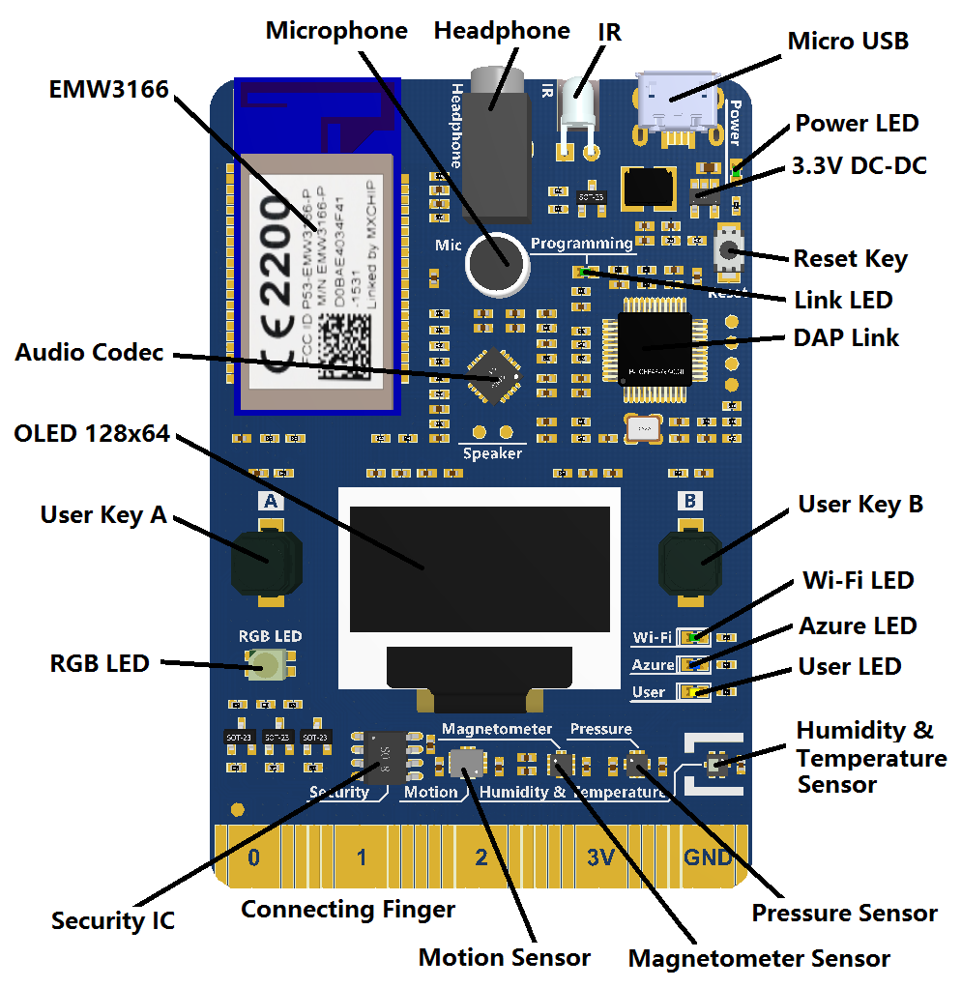
MX Chip IoT Kit

Slide 9
Push a gif
Create Arduino program that received and displays gifs from Az IoT Hub
Configure node.js server program to send gif through IoT Hub to Arduino

Slide 10
MX Chip / IoT Hub Exercise
Create IoT Hub
Create device identity
Get connection string
Use VS Code to find com port
Use putty to config wifi/ssid/iot hub connection on Az3166 board
Push and run custom device code to mxchip
Startup local node.js server to push gif
Watch the joyful gif

Slide 11
MXCHIP FROM SCRATCH – LIVE!!!!
DEMO

Slide 12
Thank you!

